Slide 1

Let’s start with Allah Yaar
Bs in Computer Science

Slide 2
Entertainment Industry
Entertainment Industry
The entertainment industry has been transformed by ICT through innovations in creation, distribution, and consumption of content.

Slide 3
Entertainment Industry
Key Areas of ICT in Entertainment:
Digital Content Creation:
Description: ICT tools enable filmmakers, musicians, and graphic designers to produce high-quality digital content.
Examples:
Video editing software like Adobe Premiere Pro for movies and TV shows.
Audio production tools like Logic Pro X for creating soundtracks and albums.

Slide 4
Entertainment Industry
Streaming Platforms:
Description: ICT supports platforms that allow users to stream content on demand.
Examples:
Netflix and Hulu for movies and series.
Spotify for audio streaming, offering tailored playlists via machine learning algorithms.

Slide 5
Entertainment Industry
Computer-Generated Imagery (CGI) and Special Effects:
Description: ICT enables realistic visual effects in films.
Examples:
Movies like The Avengers and Avatar rely heavily on CGI.
Motion capture suits used to bring lifelike movements to animated characters like Gollum in The Lord of the Rings.

Slide 6
Entertainment Industry
Virtual Reality (VR) and Augmented Reality (AR):
Description: Offers immersive experiences to users, enhancing their interaction with digital content.
Examples:
VR cinema experiences using headsets.
AR in apps like Pokémon Go, blending virtual elements into the real world.

Slide 7
Entertainment Industry
Social Media as Entertainment:
Description: ICT has enabled platforms like Instagram, TikTok, and YouTube to become primary sources of entertainment.
Examples:
YouTube creators generating millions of views with vlogs, tutorials, and web series.

Slide 8
Animation Industry
Animation Industry
ICT plays a central role in developing cutting-edge animations for films, games, and advertising.
Key Applications in Animation:
2D and 3D Animation Tools:
Description: Programs allow animators to create and manipulate characters and environments.

Slide 9
Animation Industry
Examples:
Adobe Animate for 2D animations.
Maya and Blender for 3D modeling and animation.

Slide 10
Animation Industry
Rendering Technology:
Description: Converts 3D models into photorealistic visuals.
Examples:
Pixar’s RenderMan used for movies like Toy Story.
Real-time rendering engines like Unreal Engine for animated content.

Slide 11
Animation Industry
Global Collaboration in Animation:
Description: Cloud-based ICT platforms allow animators worldwide to collaborate in real time.
Examples:
Collaborative production on projects like Frozen by Disney teams across multiple locations.

Slide 12
Animation Industry
Stop Motion Animation Integration:
Description: Combines traditional stop-motion techniques with digital tools for smoother editing and effects.
Examples:
Movies like Coraline and Kubo and the Two Strings.

Slide 13
Game Industry
Game Industry
The gaming industry is one of the most dynamic sectors transformed by ICT.
Key Aspects of ICT in Gaming:
Game Development Software:
Description: Tools assist in creating immersive gaming environments.

Slide 14
Game Industry
Examples:
Unity and Unreal Engine for building high-performance games.

Slide 15
Game Industry
Online Multiplayer Platforms:
Description: Allows players from different locations to compete or cooperate in games.
Examples:
Games like Call of Duty and League of Legends.

Slide 16
Game Industry
Cloud Gaming:
Description: Gamers can stream high-quality games without requiring powerful local hardware.
Examples:
Google Stadia and NVIDIA GeForce NOW.

Slide 17
Game Industry
Immersive Gaming with VR and AR:
Description: Provides realistic gaming experiences.
Examples:
VR games like Half-Life: Alyx.
AR games like Ingress.

Slide 18
Game Industry
AI and Machine Learning in Games:
Description: AI-driven NPCs (non-player characters) provide challenging gameplay.
Examples:
Civilization VI uses AI opponents.

Slide 19
Simulations and Their Uses
Simulations and Their Uses
Simulations replicate real-world conditions virtually, supporting training, education, and research.
Key Applications of Simulations:
Training Simulations:
Description: Used for professional training in high-risk environments.

Slide 20
Simulations and Their Uses
Examples:
Flight simulators for pilot training.
Medical training simulators for surgery.

Slide 21
Simulations and Their Uses
Military Simulations:
Description: Provide safe environments for strategy planning and combat practice.
Examples:
Virtual battlefields for strategic operations.

Slide 22
Simulations and Their Uses
Scientific Research:
Description: Simulations model complex phenomena for scientific study.
Examples:
Climate simulations to predict weather patterns.

Slide 23
Simulations and Their Uses
Business and Economic Simulations:
Description: Models are used to predict market dynamics and customer behavior.
Examples:
Financial simulations for stock market training.

Slide 24
Simulations and Their Uses
Educational Simulations:
Description: ICT-based tools create interactive learning experiences.
Examples:
Virtual labs for chemistry experiments.
Physics simulations for understanding laws of motion.

Slide 25
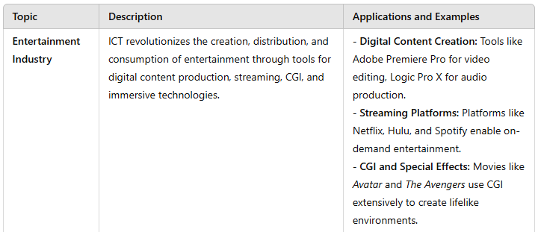
Summary Table

Slide 26
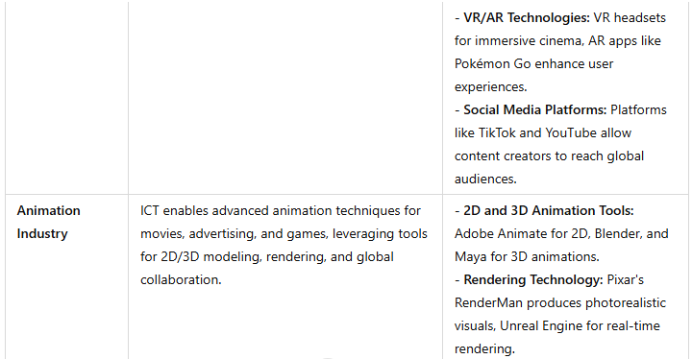
Summary Table

Slide 27
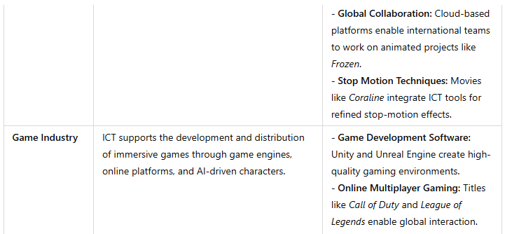
Summary Table

Slide 28
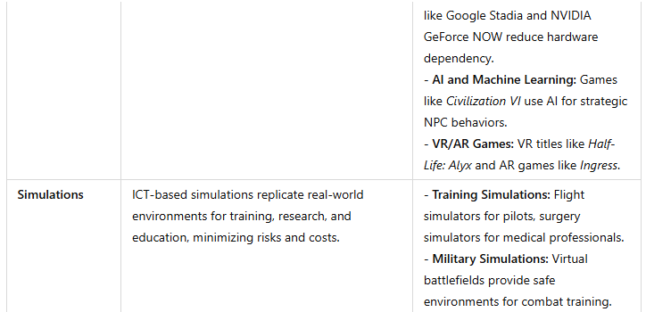
Summary Table

Slide 29
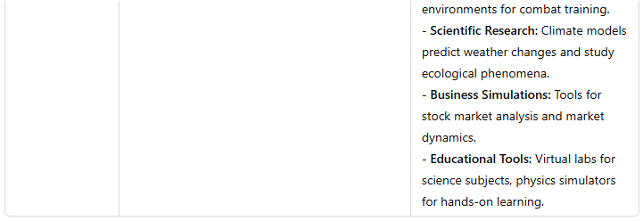
Summary Table

